Slide 1

Optimal Pizzeria Location Determination in The Bronx
Jon Wages
IBM Data Science Professional Certification
Applied Data Science Capstone

Slide 2

Business Opportunity
New York possesses a strong pizza culture and is home to the first pizzeria opened in the United States.
An estimated 62.8 million people visited New York in 2017; this number is only expected to increase.
Americans spend nearly $38 billion on pizza every year; this equates to over 3 billion pizzas sold each year.
Pizza-centric Entrepreneurs and Restauranteurs could benefit from starting a pizzeria in New York; specifically The Bronx.

Slide 3
Data Sources & Utilization
Foursquare API Data
This will provide venue data which can be utilized to determine not only which neighborhoods within The Bronx have pizzerias, but also to determine the number and frequency of pizzerias within each neighborhood.
Location Data
Location data will be obtained from the New York University Spatial Data Repository which contains a list of New York boroughs and neighborhoods.
Link to the Repository: https://geo.nyu.edu/catalog/nyu_2451_34572
Geospatial Data for Boroughs and Neighborhoods within New York
This information is housed in the above link and will be utilized to plot a map of the Bronx and provide a visual representation of neighborhood clusters according to the frequency of pizzerias within them.

Slide 4
Methodology
Utilize data from New York University’s Spatial Data Repository to obtain lists of New York Boroughs, Neighborhoods, and Coordinates.
Create a data frame using the above-mentioned data with a focus on neighborhoods within The Bronx.
Call on the Foursquare API to pull a list of venues within New York Neighborhoods.
Group the venue data by type and the neighborhoods where they are located.
Obtain the frequency of venue type for each neighborhood with a focus on pizzerias.
Use K-means Clustering to divide the neighborhoods into four clusters according to pizzeria frequency.

Slide 5
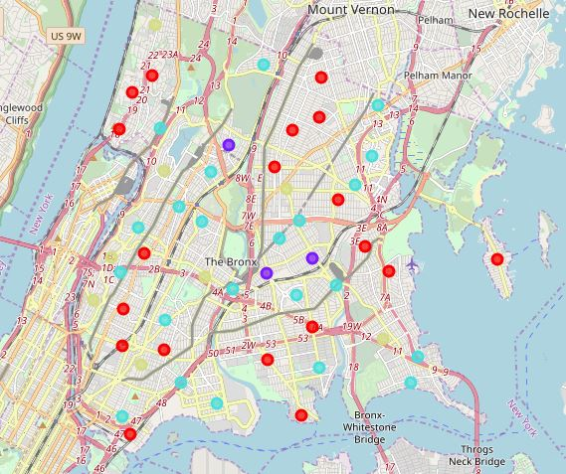
Results and Map
Cluster 1 – Represented by Red Dots
Neighborhoods with no pizzerias or a very low number of pizzerias.
There were 19 neighborhoods in this cluster.
Cluster 2 – Represented by Purple Dots
Neighborhoods with a substantially high number of pizzerias.
There were 3 neighborhoods in this cluster.
Cluster 3 – Represented by Blue Dots
Neighborhoods with a low number of pizzerias.
There were 22 neighborhoods in this cluster.
Cluster 4 – Represented by Pale Yellow Dots
Neighborhoods with a moderate number of pizzerias.
There were 8 neighborhoods in this cluster.

Slide 6
Discussion
Cluster 2 and Cluster 4
Elevated number of pizzerias
Too much potential competition
Cluster 1
Lowest number of pizzerias
Given New York’s pizza culture, this Cluster may have either no interest in pizzerias or can not sustain a pizzeria due to socioeconomic factors outside the scope of this presentation
Cluster 3
Low number of pizzerias; however, more pizzerias than Cluster 1
Provides diversity of choice as it houses the most neighborhoods.

Slide 7
Recommendation
Out of all the neighborhoods within the Bronx analyzed by this report, I would recommend pizza-centric entrepreneurs and restaurateurs focus their attention on neighborhoods within Cluster 3 when planning to either start or expand their pizza business.

Slide 8
Cluster 3
Low Pizzeria Frequency Neighborhoods
Baychester | Kingsbridge
Bedford Park | Longwood
Belmont | Mott Haven
Bronxdale | Mount Eden
Castle Hill | Parkchester
Claremont Village | Pelham Parkway
Co-op City | Throgs Neck
Eastchester | University Heights
Edgewater Park | West Farms
Fordham | Westchester Square
Hunts Point | Woodlawn

